Slide 1
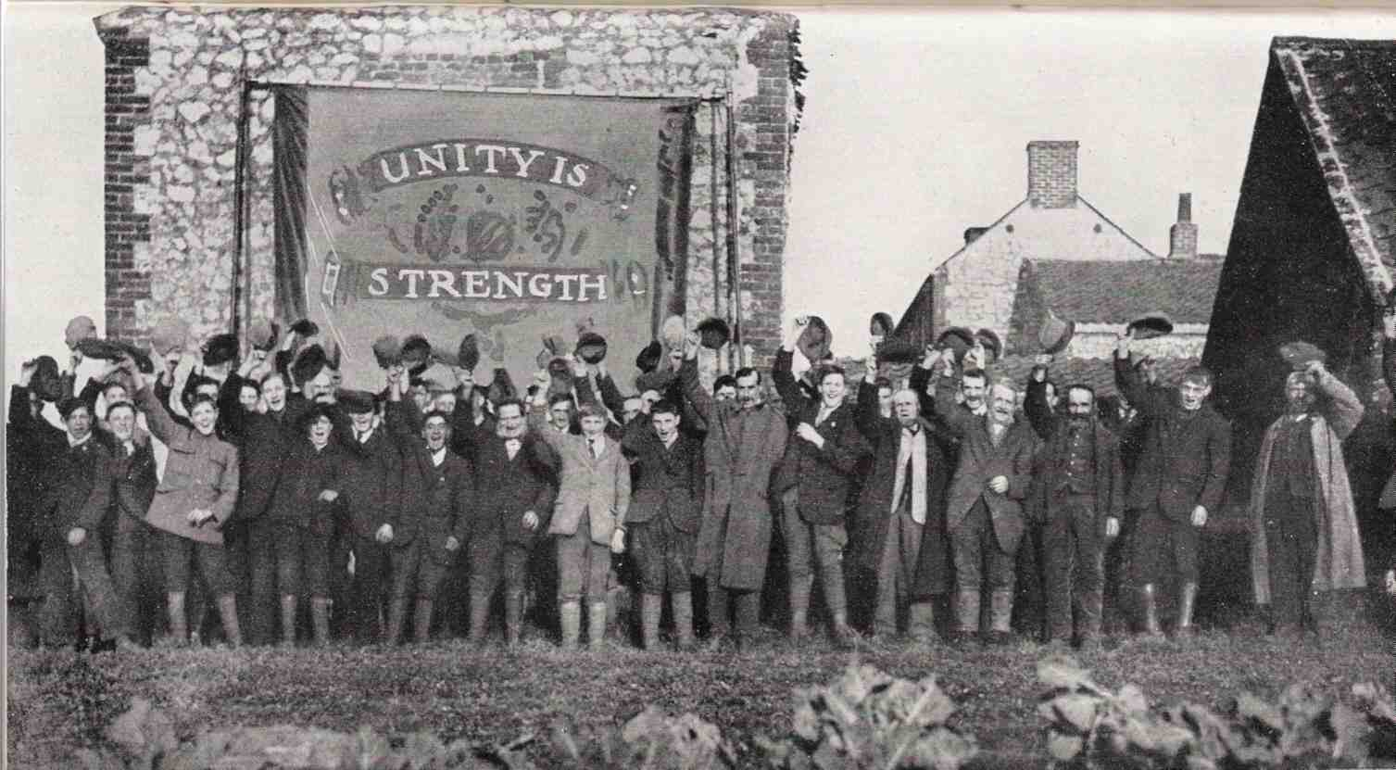

Chapter 10
Chapter 7
Industrial Relation And Disciplinary System

Slide 2
Disciplinary policies
Discipline is a management tool used to correct undesirable employee behaviour. Discipline is applied as a constructive means of getting employees to conform to acceptable standards of performance. In the context this, discipline is thus viewed as a way to correct poor employee performance. Discipline should be seen as a method of training employees to perform better or to improve their job attitudes or work behaviour. Therefore, when taken action against employees, disciplinary action should never be thought of as punishment.

Slide 3
Procedures of Managing Discipline
To manage the employee discipline, the managers responsible for it should follow a given process properly. The process can be different from one organization to another. Managers should define and use an agreed process to correct undesirable behaviour .
Although there is no specific procedure to be followed, the following steps should be taken into consideration:
An accurate statement of the disciplinary problem:
The first step is to ascertain the problem by seeking answers to the following questions.
Does this case call for a disciplinary action?.
• What exactly is the nature of the violation or offence?.
Under what conditions did it occur? Which individual(s) were involved in it?
When, or how often, did the violation occur?

Slide 4
2. Collection of data or facts bearing on the case:
Before any action is taken in a case, it is essential to collect all the fact about it. A thorough examination of the case should be made within the given time limit. The facts gathered should be realistic which can be produced before a higher authority, if and when needed.

Slide 5
3. Selection of tentative penalties:
The kind of penalty to be imposed for an employee should be determined beforehand. Should it be a simple reprimand, a financial or non financial penalty? Or should it be demotion, temporary lay-off or discharge? The penalty should be equal to the disciplinary problem. The penalty should neither be more nor less.

Slide 6
4. Choice of the penalty:
When a decision has been taken to impose a penalty, the punishment can be applied. But, it should be such that which would prevent a recurrence of the offence. If the punishment is lighter than it should be, it may encourage the violation of the same rule or another. If it is greater than it should be, it may lead to a grievance.

Slide 7
5. Application of the penalty:
The application of the penalty demands a positive and assured attitude on the part of the management. If the disciplinary action is a simple reprimand, the executive should calmly and quickly apply the action. But when severe action has to be imposed a careful and determined attitude is highly desirable.

Slide 8
6. Follow-up of the disciplinary action:
A disciplinary action should be evaluated in terms of its effectiveness after it has been taken. In other words, there should be a more careful supervision of the person against when a disciplinary action has been taken.

Slide 9
Types of Disciplinary Actions (Penalties)
Generally, there are different penalties/actions of the same offence when it is committed once, or the second time, or the third time.
a. Oral Reprimand (warning)
b. Written reprimand (warning)
c. Loss of privileges (pay cuts) Soft
d. Fines (only when rules allows)
e. Lay off (suspension)
f. Demotion (to lower post) &
g. Discharge (termination) Hard
Soft to hard approach depending upon situation, company and national rule.

Slide 10
The above concept can be expressed as given below.
SOFT Severity of progressive discipline HARD
verbal warning Written warning Pay-cuts Fines Suspension Demotion Dismissal
Progressive discipline

Slide 11
Grievance
Keith Davis: "Grievance is any real or imagined feeling of personal injustice which an employee has concerning this employment relationship."
Dale S. Beach: "A grievance is any dissatisfaction or feeling of injustice in connection with ones employment situation that is brought to the attention of management."

Slide 12

Methods and Mechanisms of Grievance Handling( Grievance Procedure)
1. Open Door Policy
According to open door policy, the doors of the offices of superiors or the management (including the CEO) must remain open for the employees to have an easy access in cases of queries. The team members should have the liberty to walk up to their team leaders and discuss issues with them on an open forum.

Slide 13
Advantages of an Open Door Policy
1. Open door policy encourages effective communication between the employee and the management.
2. There is no room for confusion when the employees directly interact with their superiors.
3. Open door policy encourages healthy discussion at the workplace.
4. The management respect the decisions of the employees to expect the same in return.
5. The management make the employees feel indispensable for the organization and lend a sympathetic ear whenever required.
6. The open door policy enables the employees to seek their boss’s help and freely discuss things with them for better clarity.
The weaknesses of grievance are the following:
An Open Door-policy Can Waste Management's Time and Decline Productivity.
Creates Dependency.
Disruption of the Chain of Command

Slide 14
2. Step ladder policy:
Under this policy, the aggrieved employee has to follow a step by step procedure for getting his grievance redressed. In this procedure, whenever an employee is confronted with a grievance, he presents his problem to his immediate supervisor. If the employee is not satisfied with superior’s decision, then he discusses his grievance with the departmental head. The departmental head discusses the problem with joint grievance committees to find a solution. However, if the committee also fails to redress the grievance, then it may be referred to chief executive. If the chief executive also fails to redress the grievance, then such a grievance is referred to voluntary arbitration where the award of arbitrator is binding on both the parties.

Slide 15
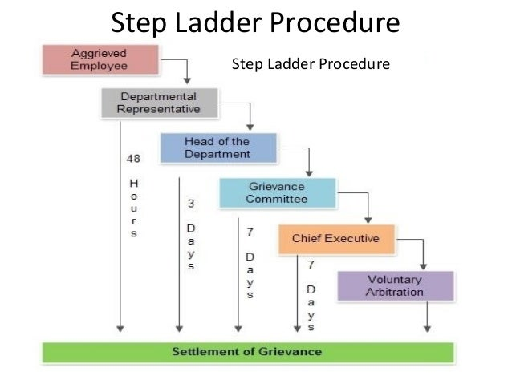

Slide 16
How to handle an employee grievance?
Establish whether the grievance needs to be resolved formally or informally.
Choose an appropriate manager to deal with the grievance.
Carry out a full investigation and gather all relevant evidence, sending it to the employee in advance of the meeting.
Arrange the grievance meeting, inviting the employee and reminding them of their statutory right to be accompanied.
Make sure accurate notes are taken throughout by a person who is not involved in the case.
Give the employee the opportunity to explain the details of their grievance and what they would like the outcome to be.
Adjourn the meeting consider the evidence before making a decision.
Inform the employee in writing of the decision, explaining how and why the decision was reached.
Notify the employee of their right to appeal against the outcome of the grievance procedure.

Slide 17
Methods of Reducing Employee Complaints (Grievances)
Popular methods to reducing employee complaints are:
Right man at the right job 4. Employee survey
Education and training 5. participative Technique
Proper supervision 6. Proper communication
7. A System of equity and fairness

Slide 18
METHODS OF REDUCING …………
1. Right man at the right job: A major source of complaint from employees side is about the job itself. If there is mismatch between demand of the job and ability and interest of the employee the complaint will increase naturally. So, one way to reduce the employee complaint is place right man at the right job.
2. Education and training: Most of the repetitive types of complaints concerning job, supervision, rewards, organizational culture can be reduced by the way of systematic and repetitive education, and training.

Slide 19
3. Proper supervision: A major source of complaint from employees side is about supervision like autocratic style, too much or two low supervision, harassment, one way communication, etc. So, Proper, timely, and friendly supervision can reduce employee complaint.
4. Employee survey: HR managers with the help of other line managers need to organize employee survey at a specific interval of time. This technique helps to identify the source of complaints. So, mangers can install preventive measures to minimize the complaints.

Slide 20
5. Participative techniques: Participative decision techniques promote source of ownership, motivation and morale of the employees. When they are involved in decision-making that affects them naturally there will be less chances of complaints.
6. Proper communication: It helps employees to understand expected behaviour, performance standards, policies, etc. All these activities ultimately help to increase the employee motivation. As the motivation increases complaints are sure to decrease.
7. A system of equity and fairness: Other major sources of employee complaints are unfair and equitable treatment in terms of pay, promotion, and other types of activities. So, managers can reduce complaints by applying equity and fairness in the organization (among the employees) as far as possible.

Slide 21
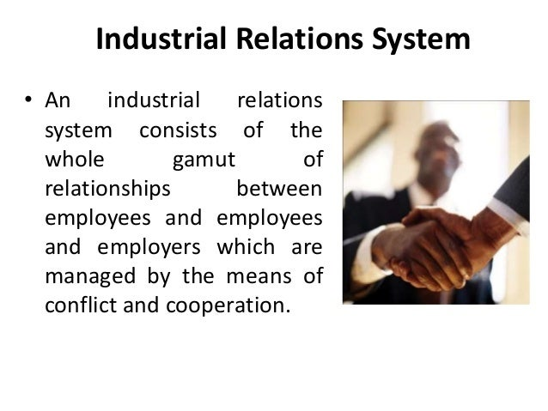

Slide 22
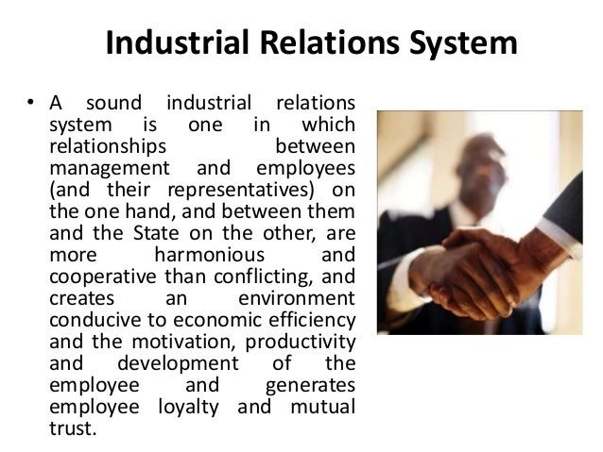

Slide 23
Industrial Relation And Disciplinary System
John T. Dunlop: "Industrial relations are the complex of inter-relations among workers, managers and government.“
H.A. Clegg: "Industrial relations include the study of workers and their trade unions, management, employers' association and the state institutions concerned with the regulation of employment.
International Labour Organization (ILO): "Industrial relations deal with either the relationships between the state and employers and workers organization or the relation between the occupational organization themselves."

Slide 24
ILO uses the expression (LRs/IRs) to denote such matters such as:
Freedom of association and the protection of the right to organize,
The application of the principles of the right to organize and the right of collective bargaining, collective agreements,
Conciliation and arbitration, and
Machinery for cooperation between the authorities and occupational organizations at various levels of economy.
Conclusion: IRS/LRs, when taken in wider meaning industrial relationship is a set of functional interdependence involving historical, economic, social, psychological, demographic, technological, occupational, political and legal variables.

Slide 25
Industrial Relations – Objectives
The primary objective of industrial relations is to bring about sound and healthy relations between employers and employees.
In addition to the primary objective, industrial relations aim:
(i) To facilitate increased production and productivity;
(ii) To safeguard the rights and interests of both labor and management by enlisting their co-operation;
(iii) To avoid unhealthy atmosphere in the industry, especially work stoppages, go-slows, strikes, lockouts; and
(iv) To establish and maintain industrial democracy;
(v) To achieve a sound, harmonious and mutually beneficial labor management relations.

Slide 26
Industrial Relations – Objectives contd……….
(vi) To correct an imbalanced, disordered and maladjusted social and economic order with a view to reshape the complex socio-economic relationships following technological and economic progress;
(vii) To control and discipline and parties concerned and adjust their conflicting interests.
(viii) Improvement in the economic conditions of workers in the existing state of industrial management and political government;
(ix) To regulate production and promoting harmonious industrial relations;
(x) Socialization or rationalization of industries by making the state itself a major employer; and
(xi) Vesting of a proprietary interest of the workers in the industries in which they are employed.

Slide 27
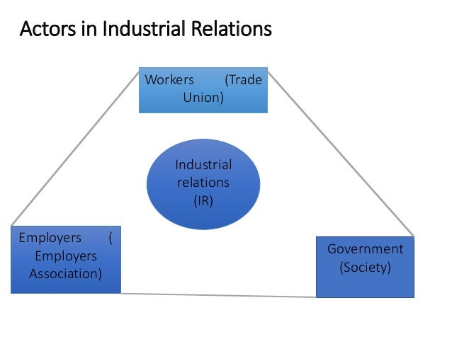

Slide 28
Process of Labour Relations
The process of labour relation can be divided into two parts (a) at an enterprise level (micro perspective), and
(b) mixed perspective as discussed below:
1. Legal existence of management and union.
2. Unionization 4.Collective bargaining
3. Problem or opportunity situation 5 . Negotiation or contract settlement
6. Implementation and follow up of contract
A. Process of LRs: At an Enterprise Level (Micro Perspective)

Slide 29


1. Legal existence of management and union: The fundamental property of a good IRs system (process) is the recognition and existence of the freedom of association. That freedom is applicable to both employers and workers. The freedom must include recognition of organizations of workers and employers. Those organizations must be autonomous and independent bodies. They must not be dominated by each other or by the government.
2. Unionization: This is the second step in the process of IRs at enterprise level. Trade unions are a device which enables a group to bargain. They bargain with any other class or group on equal footing. These unions (unionisms) are: (a) Economically oriented, and (b) An instrument of defense against exploitation. Parties (actors) go through unionization because they are constrained by circumstances to do so.

Slide 30

3.Problem or opportunity situation: These two major factors give birth to the third step in LRs. Problem or opportunity situation gives birth to dispute or conflict (for details see disputes topic in this book or conflict topic of OB book). In other words, to start the process of labour relations there must be the: (a) existence of new problem, or (b) an opportunity to grasp. The process can be initiated by either party of IRs.
4. Collective bargaining (CB): It may take at the national, industry or enterprise level. Since we are discussing LR at micro level (enterprise level) so the coverage of CB is also limited to an organization. CB is a means of setting issues or problems relating to terms and conditions of employment. A detailed discussion of collective bargaining will be made in coming paragraphs.

Slide 31
5. Negotiation or contract settlement: The bipartite (two party) CB process usually start with a list of demands being presented to the management. Demands are the unions on behalf of their members/workers. Ultimately, both of the parties come to a negotiation or they settle a contract. These contracts/ negotiations have legal and moral values to the conflicting parties.
6. Implementation and follow-up of contract: Both management and union should strictly implement the promises stated in the contract. The contract must be properly communicated. Lack of proper communication can lead to misunderstanding and even to strike. Sometimes managers and supervisors who are ill-informed may adversely mislead the workers about the implementation and follow-up. Proper implementation and follow-up is likely to ensure greater acceptance- and therefore better IRs.

Slide 32
B. Process of LRs at Three Different Levels (Mixed Perspective)
Industrial relations operate at different levels:
At the national level: At this level industrial relations operates so as to formulate labour relations policy. In market economies this is usually done through a tripartite process. This process involves government, employers and workers and their representative organizations.
At the industry level: At this level industrial relations often takes the form of collective bargaining. It takes place between employers organizations and unions. This process may result in determining wages and other terms and conditions of employment for an industry or sector. It may also result in arrangements on issues. Those issues must be of mutual concern such as training, ways of avoiding or settling disputes, etc.
At the enterprise level: At this level the relationship between employers and workers is more direct. And the interests of workers may be represented by unions. Employers' organizations are not usually involved at the enterprise level in representing the employers interests with workers or their union.
Conclusion: Sound industrial relations at the national level build trust and confidence

Slide 33
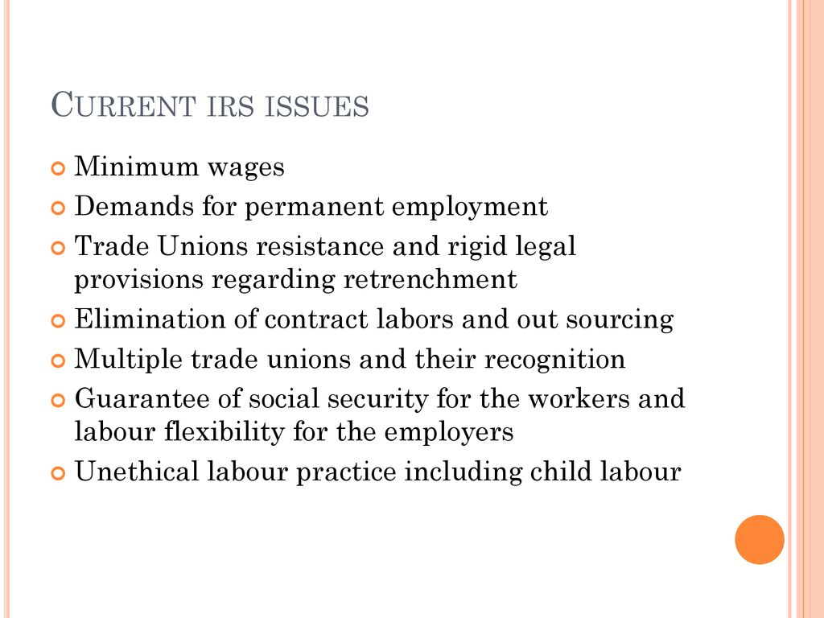
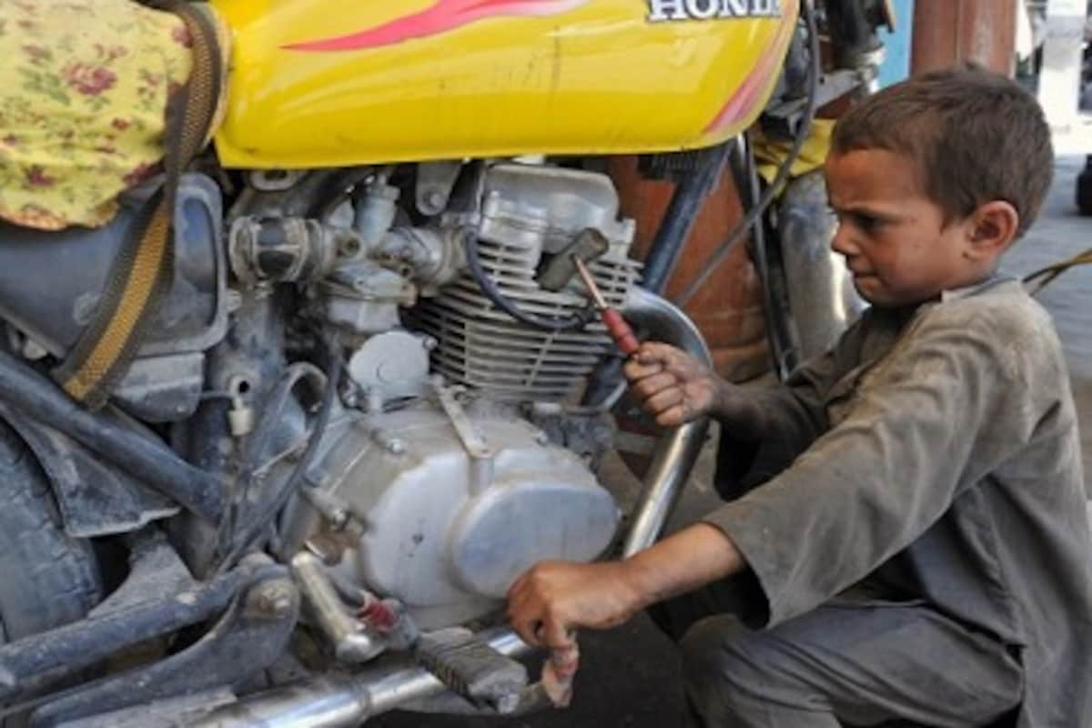
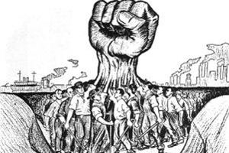

Slide 34
Trade Union
Decenzo & Robbins: A union is an organization of workers, working collectively, seeking to promote and protect its mutual interests through collective bargaining.
G.D.H. Cole: "A trade union means an association of workers in one or more professions - an association carried mainly for the purpose of protecting and advancing the members' economic interests in connection with their daily work.“
Roverts Dictionery of IRs: "It is an association of workers in a particular trade or a craft organized to promote a common interest and to further that interest through negotiation of wages, hours and other conditions of employment."

Slide 35
Characteristics of Trade Unions
Association of employees: A trade union is essentially an association of employees belonging to a particular class of employment, profession, trade or industry. For example, there are unions for teachers, doctors, film, artistes, weavers, mine workers and so on.
Voluntary Association: An employee joins the trade union out of his free will. A person cannot be compelled to join a union.
Permanent Body: A trade union is usually a permanent body. Members may come and go but the trade union remains.
Common Interest: The member of a trade union have certain matters of common interest-job security, better pay and working conditions and so on, which bring them together.

Slide 36
Collective Action: Even when an individual employee has any grievance over certain management decisions, the matter is sorted out by the intervention of the trade union Employees are able to initiate collective action to solve any problem concerning any particular employee or all the employees.
Rapport with the Management: The trade union seeks to improve relations between the employees and employers. The officials of the trade union hold talks with the members of the management concerning the problems of the employees in order to find an amicable solution. It is thus possible for the employees to have better rapport with the management.

Slide 37
Why do Workers Join a Trade Union? (Reasons)
Job Security:
Employees need to have a sense of job security and want to be sure that management will not make unfair and arbitrary decisions about their employment. They look unions to ensure that their jobs are duly protected against lay offs, recall, promotion, etc.
Wages and Benefits:
Employees work for livelihood, i.e., bread-and-butter. Obviously, bread-and-butter issues of em­ployees are always important issues in their unionization. The employees may think that the union, with its united strength, will ensure fair wages at par with those of other workers in the community, benefits such as medical facility, pensions, paid sick leave, vacations and holidays for them.

Slide 38
Working Conditions:
Employees like to work in a healthy and safe environment. Although there are statutory provisions for providing employees a safe work environment employees still feel more secured knowing that trade union is directly involved in safety and health issues relating to them.
Fair and Just Supervision:
The days are long gone when managers / leaders could rule employees with an iron fist. Thanks to the trade unions that brought about a change or shift in leadership styles from autocratic to democratic, or say, people oriented to ensure that the managers treat their employees fairly, justly, and respectfully. Employees can only be disciplined for “just cause.” In case of mistreatment from the employer, the employee may file a written grievance against the employer.

Slide 39
Powerlessness:
Employees individually often feel voiceless or powerless to bring about changes that will benefit them’. But, it is union that provides them a powerful, collective voice to communicate to management their dissatisfaction and frustration. This is based on labour philosophy ‘unity is the strength”.
Need to Belong:
Man is a social animal. Hence, need to belong is strong in both his personal and work lives. The union, from this point of view, provides a mechanism for bringing people together not only to promote common job-related interests but also to organise programs, functions, and social events from time to time, to create a strong bond among the union members’.

Slide 40
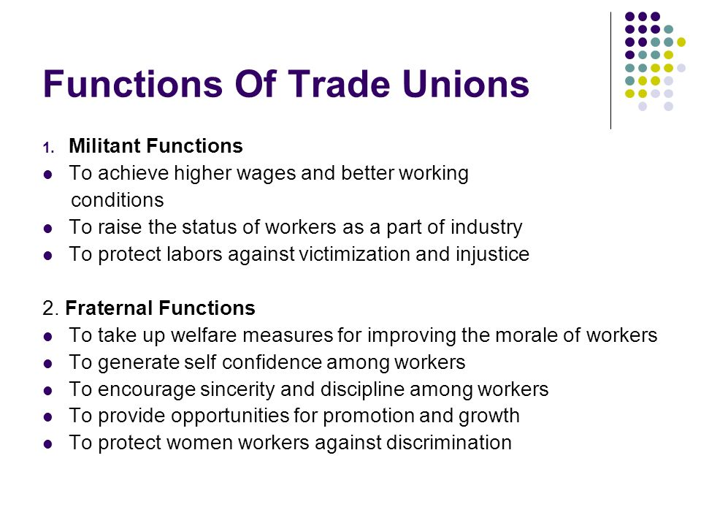

Slide 41
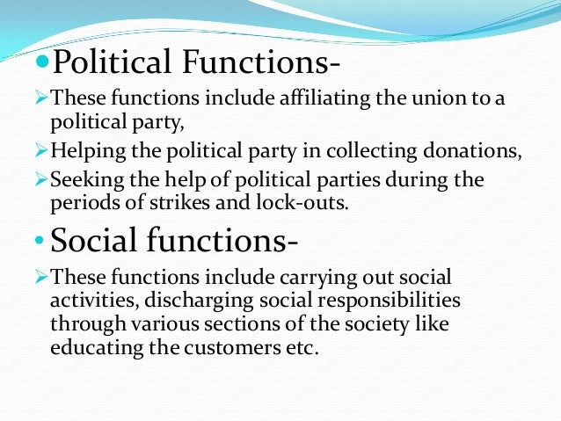

Slide 42
Leadership of Trade Unions
The leadership of trade unions are dependent upon the structure of the trade unions. So the leadership of trade union is also structure based. For example:
Local unions and leadership: They serve the needs of the local trade unions. Every organization has its own trade union and leader as well. All these unit level leaders may elect one of them as district level union leader and team members.
Regional unions and leadership: Besides these, there are also some regional union offices and corresponding leaders like in India. And may be in Nepal in near future. These regional unions are affiliated to national (central), level unions.
National unions and leadership: As discussed earlier there are apex organizations likeGFONT, GCONT, etc. in Nepal. They operate at national level only. The leaders ofthese unions are national level representatives. These unions and their leaders dealwith policy matters and macro level issues.

Slide 43
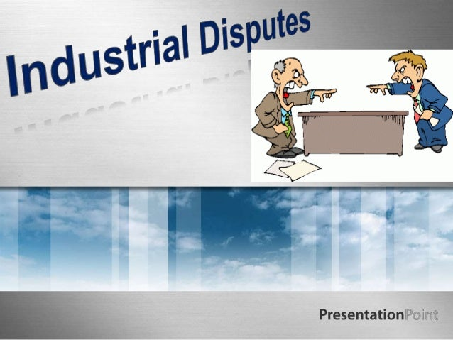

Slide 44
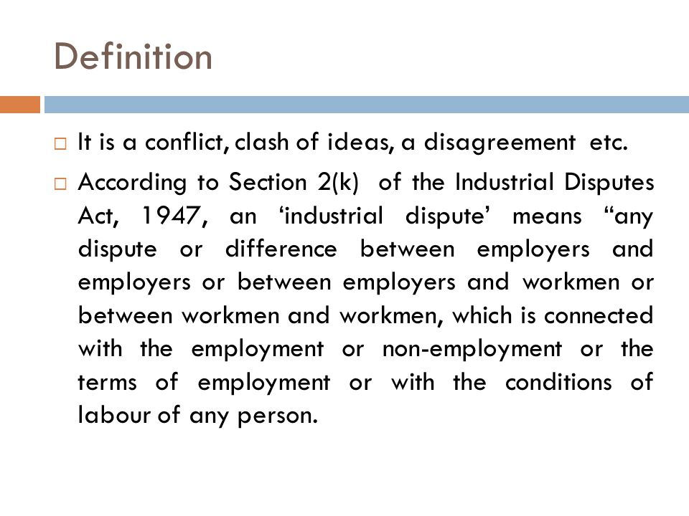

Slide 45
In Nepal, the provision relating to industrial dispute was (for the first time), provided by her first labour legislation "Nepal Factory and Factory Workers Act, 1959, (NFFWA)" which was replaced in 1992. The existing (Nepal) Labour Act, 2074, interprets the following claims /complaints / demands as the labour disputes.
A. Individual claims or complaints of one or more workers/employees against the manager in respect of matters concerning service, and
B. Demands or claims relating to the workers/employees' collective rights, interests, and facilities submitted to the managers.

Slide 46
Scope of Labour/Industrial Disputes
Labour disputes are the conflicts. They are related to the terms and conditions of employment service and collective labour rights and welfares in the establishment. In Nepal, all kinds of individual or collective claims, complaints (or demands) made by the workers do not fall under the labour disputes. In the perspective of the national labour legislation, the following demands of the workers made to the management could not be considered as the labour disputes.
Demands or claims which contravene /contradict the constitution of Nepal,
Demands or claims which are made on the basis of baseless changes, against interests of any side,
Demands which concern matters adversely affecting the personal conduct of any worker,
Demands or claims which are not connected with the establishment, and
Demand or claims which concern a collective agreement that has been concluded less than two year previously.

Slide 47
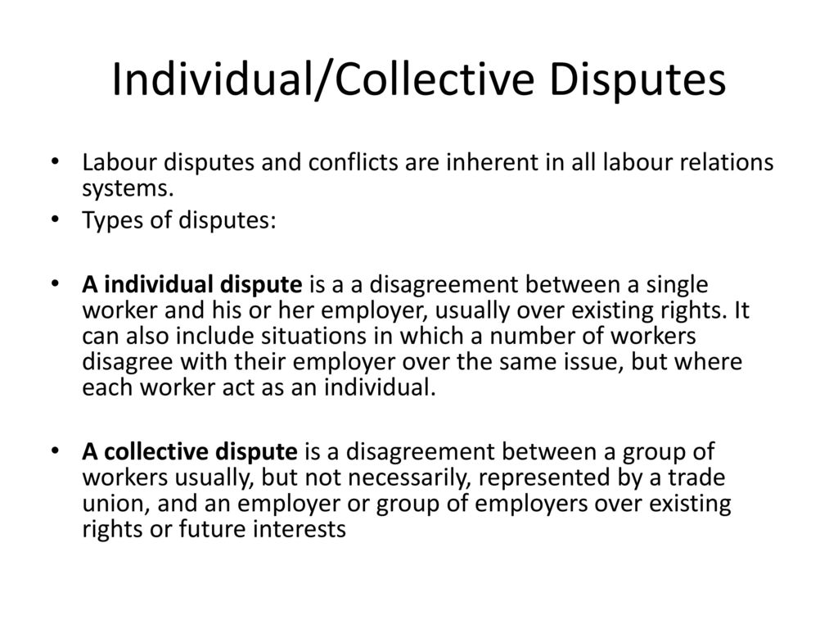
Labour Disputes may be of various types. But, in Nepal, they may be classified into two categories:

Slide 49
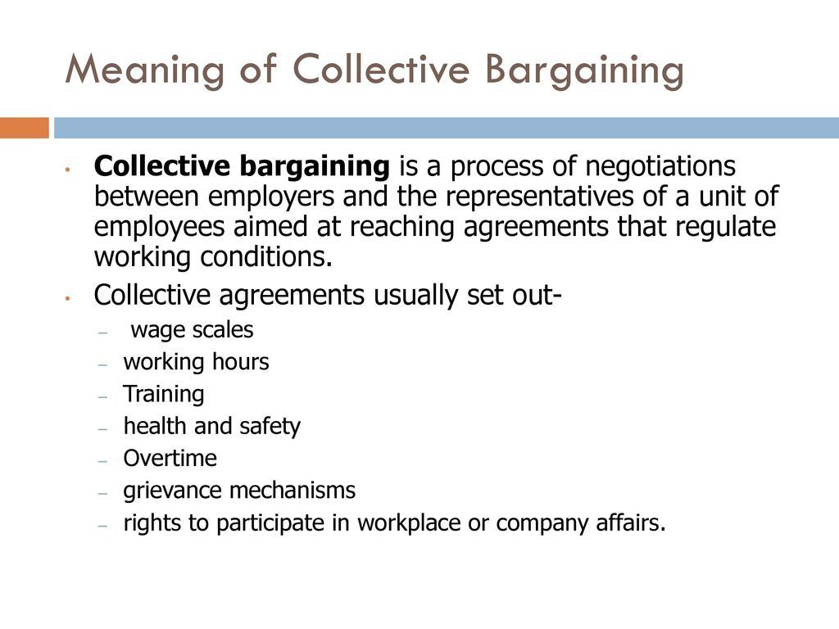


Slide 50
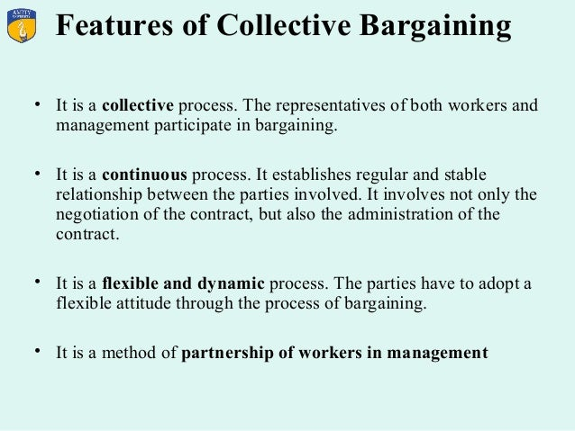

Slide 51
PROCESS OF COLLECTIVE BARGAINING
The collective bargaining process involve five steps:
Prepare: This phase involves composition of a negotiation team.
2. Discuss: Both parties decide the rules that will guide the negotiations
3. Purpose: It involves the initial opening statements and the possible options that exist to resolve them.
4. Bargain: Negotiations are easy if a problem solving attitude is adopted. This stage comprises the time when 'what ifs' and 'supposals' are set forth and the drafting of agreements take place.
5. Settlement: This stage is described as consisting of effective joint implementation of the agreement through shared visions, strategic planning and negotiated change.

